Slide 1

FAP COMPANY

Slide 2
Nhóm 6
Nguyễn Minh Nhân
Nguyễn Anh Duy
Mai Đức Đỗ Đạt
Nguyễn Công Thành
Hồ Tấn Tài
Lê Phạm Ngọc Thiện

Slide 3
General Introduction About FAP Company
Deliver a superior mobile experience to your customers. As one of the leading mobile application development companies, we have many years of experience creating innovative, high-quality applications for our customers.
We turn great ideas into great software products. We are building a new generation of innovative software companies and providing software services to everyone.

Slide 4
STRATEGIC OBJECTIVES
Building FAP to become the leading company providing Software solutions and Value-Added Services in Vietnam.
By the efforts of each individual and the whole company, meeting the needs of customers and always trying non-stop to bring high efficiency to customers. For all customers, big or small, the company is committed to building long-term and trusting relationships

Slide 5
MISSION AND PHILOSOPHY
Business philosophy:
Customer is the center: Respect and keep a polite attitude towards
customers, deal with customers' needs enthusiastically and thoughtfully,
clearly explain and fully guide necessary issues for customers. row.
Continuous innovation
Never stop creating
Value of success:
Solidarity
Share
Sincere
Creativity

Slide 6
QUALITY POLICY
For customers:
Building and maintaining relationships with customers is a condition of the
Company.
Strive to serve customers in all circumstances, and explain the details based
on the customer's understanding.
Provide customers with suitable products, with outstanding quality.
For employees:
Promote training to help each employee become a better person.
Ensure employees' efforts are recognized and rewarded by the Company.
Create the necessary opportunities and conditions as well as the space large
enough so that each employee can develop his or her full potential.
Ensure each employee has a stable life and competitive income.

Slide 7
THE POWER OF FAP
Team of talented engineers and managers
Highly qualified staff
Invest heavily in coaching and training
Experience in implementing large projects

Slide 8

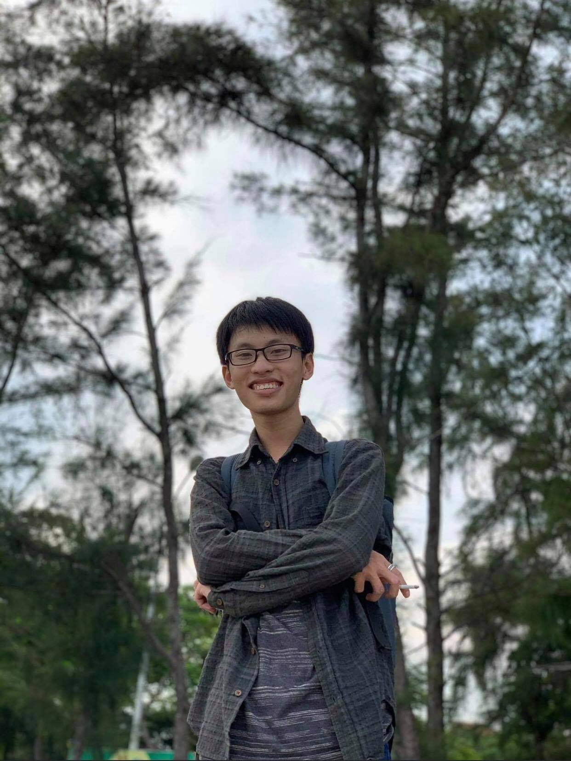
TYPICAL EMPLOYEES OF THE COMPANY
Nguyen Minh Nhan. Graduated from Nguyen Tat Thanh University.Completed major projects. Used to work at software companies big in Vietnam like FPT
Nguyen Anh Duy .Playing a key role in deploying software systems at large telecommunications companies

Slide 9


Ho Tan Tai. Successfully completing projects large and small, always with new ideas
Le Pham Ngoc Thien. Having worked in many companies and have a good understanding of the market.

Slide 10

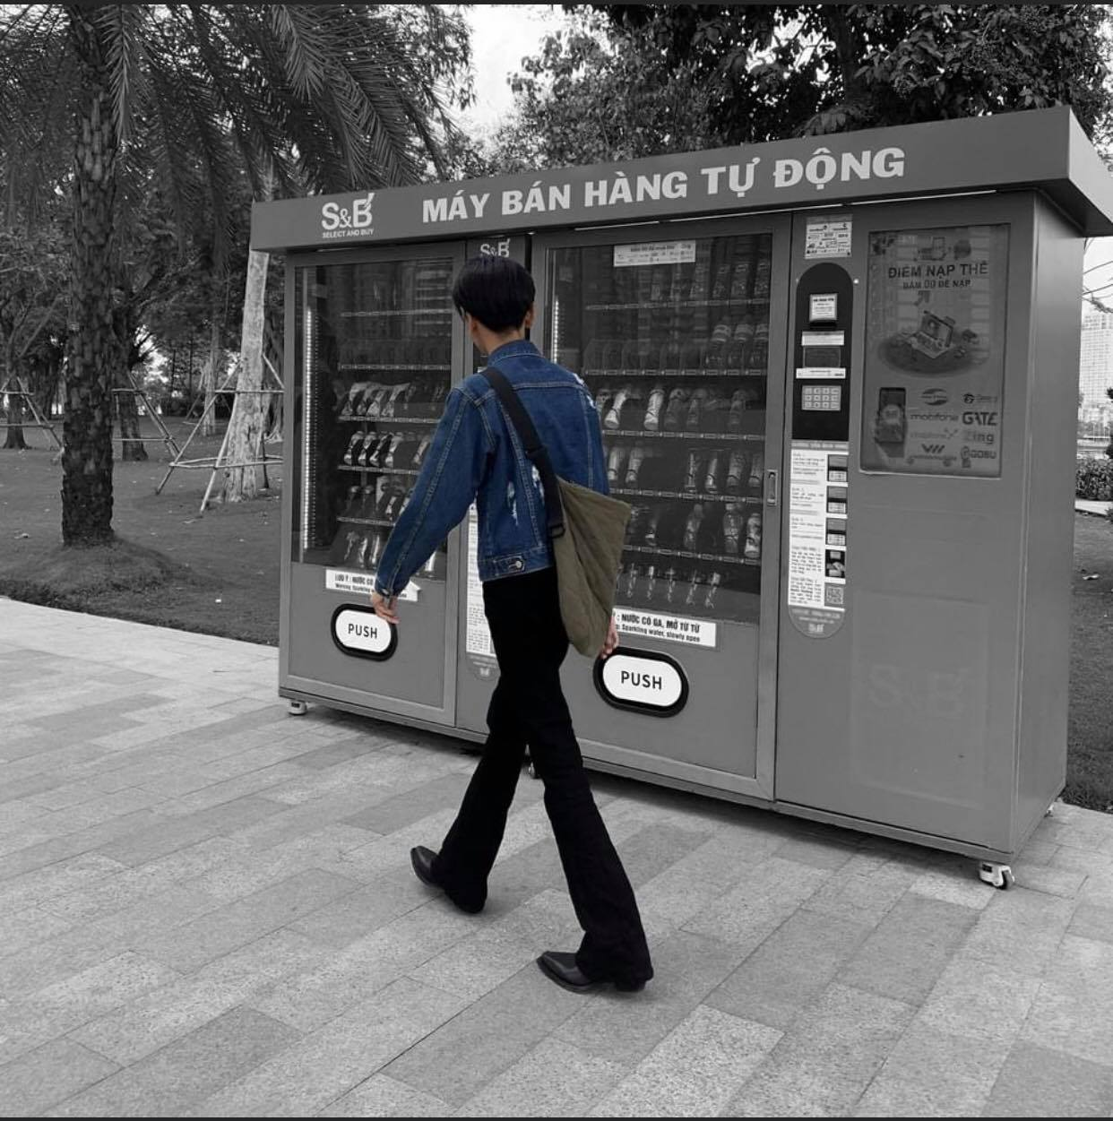
Nguyen Cong Thanh has experience in international diplomacy
Mai Duc Do Dat. Graduated from Havert University, and transferred to Vietnam

Slide 11
Our Software Service
With a highly qualified staff, we always give our customers the best. These are the services of our company:
Design management software / website
Designing software / websites with special functions
Small software design, tool auto
Great project / assignment for software / website design

Slide 12

Design management software / website
Includes the following costs:
Database analysis and design: 12.5$
Interface design (Front-end) (applicable to website
only): 21%
Design software / website: 6.5$ / interface
Test: 9$
Support installation, server configuration, good
website/software: 4$
Average price: 125$-210$

Slide 13

Designing software/ Websites with special function
Management software,
news site, sales, product
introduction...): price
negotiable
Average price: 41$-200$

Slide 14

Small software design, tool auto
8$- 20$ (depending on function)

Slide 15

Great project / assignment for software / website design
Includes the following costs:
- Database analysis and design: 13$
- Interface design (Front-end) (applied to website only): 17$
- Design software / website: 6.5$ / interface
- Cost of commenting code (optional): 1$ / interface

